Slide 1
Final Thoughts

Slide 2
(hopefully) this isn’t the end
You now know enough to transition into using R for all of your data cleaning and analysis
(way more than I did when I gave up SPSS)

Slide 3
(hopefully) this isn’t the end
Best way forward is to take a project you’re already working on and either move it to R, or duplicate your work in R to check it

Slide 4
Things we didn’t get to cover
Plotting in R
Structural equation modelling in R

Slide 5
Plotting: ggplot2
Plotting in R is mostly through the ggplot2 package and works with the concepts of ‘geoms’ and ‘layers’
Basically, you put your graph together piece by piece, adding a line of code to adjust each little thing you want to tweak.

Slide 6
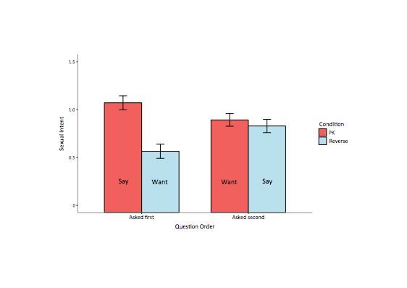
Graph of sexual intent by manipulation and question

Slide 7
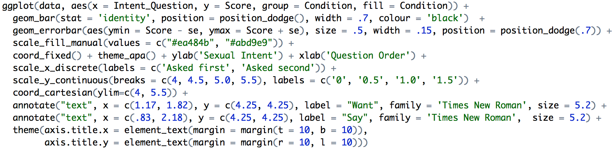

Slide 8
Plotting: ggplot2
I often just look up the code I need for plotting as I go, since I don’t do it often (You’ll often only learn by heart the code you often need to use)
http://www.cookbook-r.com/Graphs/

Slide 9
Plotting: ggplot2
Other resources if you want to learn the concepts and become a wizard at graphing:
http://tutorials.iq.harvard.edu/R/Rgraphics/Rgraphics.html
http://docs.ggplot2.org/current/

Slide 10
Structural equation models
Done through the lavaan package
Models specified with formulas (similar to lm)
Very powerful syntax
The lavaan package has it’s own website with very good examples and tutorials

Slide 11
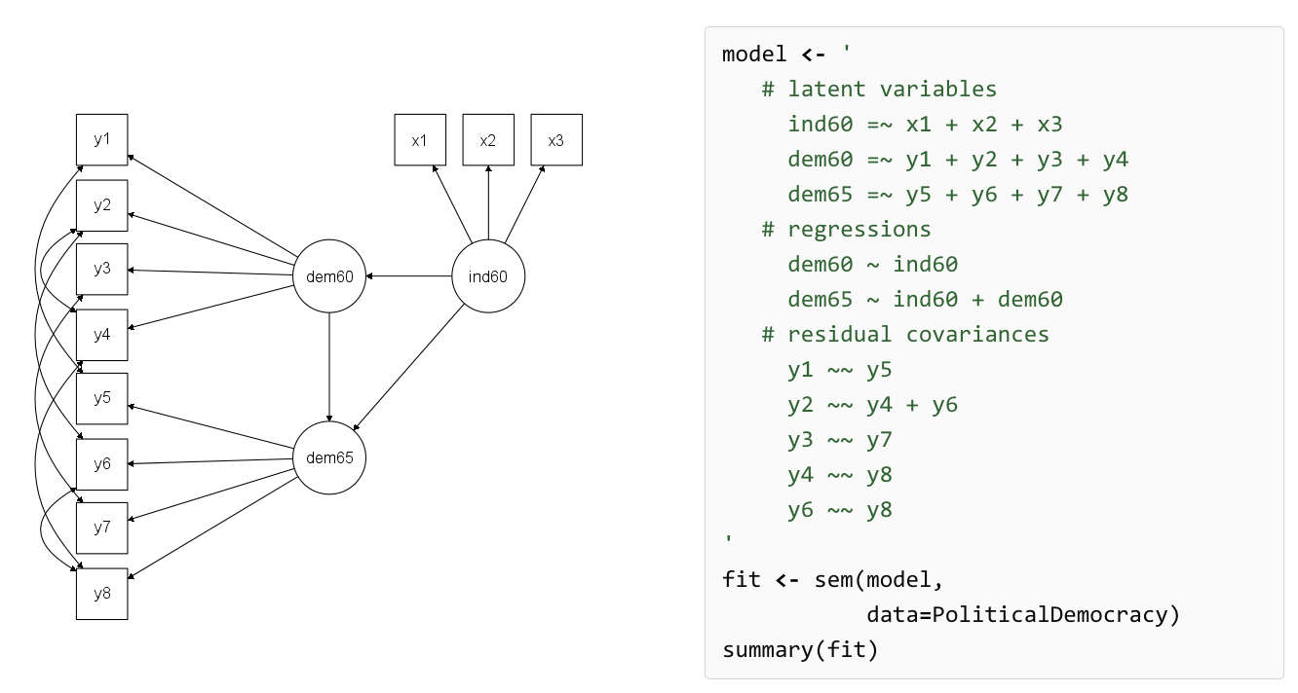
Lavaan
http://lavaan.ugent.be/

Slide 12
More on data tidying and visualisation
http://r4ds.had.co.nz/index.html
http://garrettgman.github.io/tidying/
http://stat405.had.co.nz/
https://ramnathv.github.io/pycon2014-r/explore/README.html

Slide 13
Learning regular expressions
I showed how powerful regular expressions can be in our demonstrations. They actually don’t take long to learn at all.
A good (half hour) introduction is available here: https://regexone.com/
A thorough reference here: http://www.regular-expressions.info/

Slide 14
Multilevel modelling
A lot of good resources in textbook form
Nezlek - multilevel modelling for personality and social psychology
Good introduction, focusing on concepts
German & Hill - Data analysis using regression and multilevel/hierarchical models
Heavier and more technical, but also very thorough and has examples in R

Slide 15
R packages
ggplot2 (advanced plotting)
psych (has personality-centric functions - good for scale creation and factor analysis)
lme4 (mixed effects models)
lmerTest (gives p values for lmer models)
lavaan (sem + confirmatory factor analysis)
reshape2 (switching data from wide to long)
tidyr (functions to deal with common challenged encounter when setting data up with reshape2)
stringr (functions to work with character data, useful for data cleaning)
devtools (lets you install from Github)
haven (reads SPSS data)
igraph (social network analysis)
jsonlite (dealing with JSON data)
MTurkR (lets you use Mturk through R)
TwitteR (lets you access Twitter data)
plyr, dplyr (data management packages to do complicated aggregation and reshaping)
Hmisc (gives nice correlation tables with significance stars)
Smisc (My package, has tools to read in Qualtrics datasets and a few other bits and pieces)
Rcurl & XML (packages to let you read data in from the web and do web scraping)
Knitr (package to create LateX pdfs - what I used to make the day 1 handout)
xlsx (let’s you read in excel spreadsheets with separate sheets, not just .csv files)

Slide 16
Packages
There’s usually a best package for any given purpose in R
They usually have good documentation if you google the package name + ‘Introduction’ (it might not come from the authors)
Rely on this more than the actual help files in R. Package documentation there is usually more of a reference than a how-to.

Slide 17
The process of learning in R
Encounter new problem
Think about the logical steps you’d need to take to solve it - i.e. what needs to happen
Assuming you don’t know how to make those things happen, you search online sources and find the answer
That answer becomes part of your repertoire

Slide 18
Where to look?
http://stackoverflow.com/questions/tagged/r
http://www.statmethods.net/
https://www.r-bloggers.com/
Or google it!

Slide 19
Good luck!
Thanks for attending and making it a great experience for me!
Especially for staying until Week 6
Please get in touch if you have questions or issues you can’t resolve (but do try yourself, it’s part of learning!)

